Slide 1
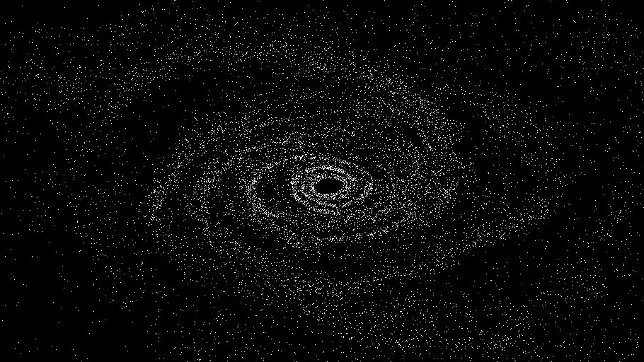
N-Body Simulator

Slide 2
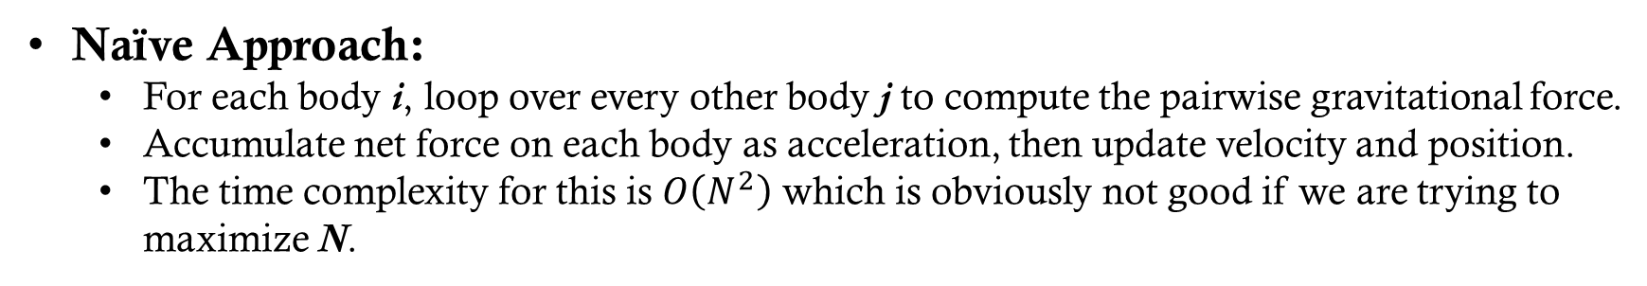
Problem
Goal:
Simulate the motion of N celestial bodies over time, governed by Newton’s Law of Universal Gravitation. Each body interacts with every other via gravitational forces, influencing acceleration, velocity, and position.
I want to do this in real time.
Classic High Computation Problem:
Each of the N bodies must calculate its net force from interacting with the other bodies.
At each time step, the forces between body pairs can be computed independently, making the problem obviously parallel.
Naïve Approach:
For each body i, loop over every other body j to compute the pairwise gravitational force.
Accumulate net force on each body as acceleration, then update velocity and position.
The time complexity for this is $O\left(N^{2}\right)$ which is obviously not good if we are trying to maximize N.
Notes:
Most n-body simulators will slowly generate a collection of position points for each frame and save all this data to do visual processing after computation. My challenge is that I want my simulator to run in real time.

Slide 3



Technologies
Simple and Fast Multimedia Library
Window management
Graphics rendering
Sf::Vector2f
BS::thread_pool
Created by Barak Shoshany
A fast, lightweight, C++ thread pool library

Slide 4
Barnes-hut algorithm
S
D
if (s/d) < θ:
useCOM()
if numRegionBodies > capacity:
subdivide()
Notes:
Before we parallelize the problem, we can look at alternative algorithms.
If a group of bodies is far enough away, just treat it as one body with a mass equal to the sum of all the masses in its region and its position as the center of mass of the region. Then use this single body to approximate the force calculation for this body.
To determine if a group is far enough away for approximation, we will use the quotient s/d. Where s is the size of the region and d is the distance to the group. This criteria will be satisfied if the quotient if less than some constant we set, θ.
If a region does not satisfy our criteria, then we can recurse into smaller subregions. Since these regions are smaller, they are more likely to satisfy our criteria.
The check for if we should subdivide is when a regions capacity is over a set parameter, this keeps things simple.
This quadtree is remade each timestep, which takes $O\left(Nlog(N)\right)$time. However, if many particles are close, this can degrade into $O\left(N^{2}\right).$

Slide 5
Building Quad-Tree
Capacity = 1
root
NW
NE
NW
NE
SW
SE
SW
SE
Example

Slide 6
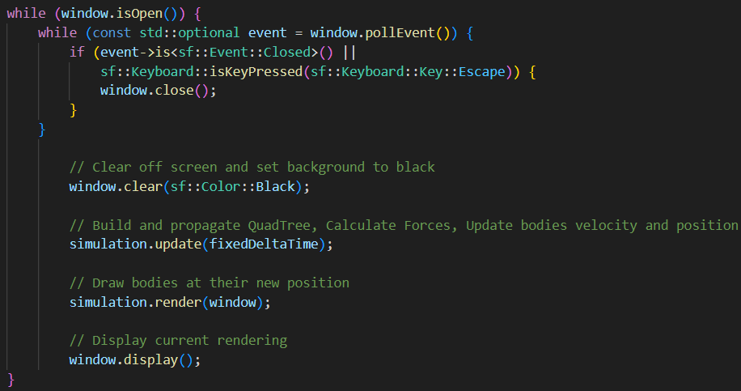
data flow (per time-step)
Each Time-Step:
Notes:
This is loop for a single time-step.
As you can see,
we first open a window
Then we tell SFML to clear the screen to black
Then we run one iteration of the simulation with a fixed time
Then we tell call a render function that will draw all the bodies
Finally, we tell SFML to render the newly drawn bodies

Slide 7
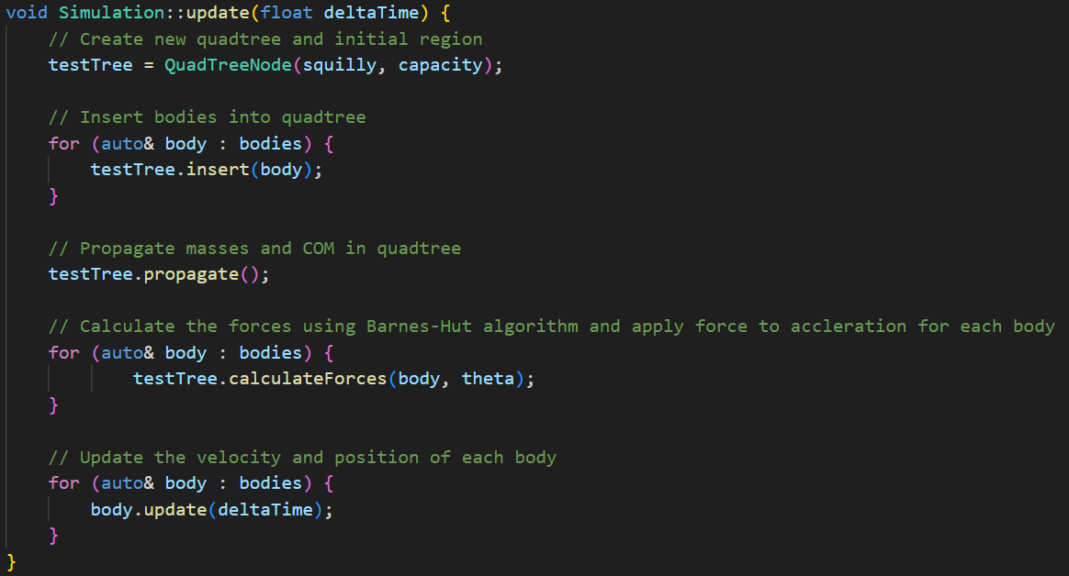
Simulation.update()
1. Build Quadtree
2. Calculate the forces on the bodies
3. Update all bodies position and velocity
Notes:
If we look into the simulation update function, we see three main sections:
First we build the quadtree
This is done by creating a new quadtree with an initial region that is equal to the size of the window
Populating the tree with bodies
Then propagating the masses and center of masses up through the internal nodes
The next thing we do in a time step is calculate the forces using the Barnes Hut approximation
Lastly, we update the velocity and position vectors of each body. This is done with the acceleration vectors produced by the calculate forces funciton

Slide 8
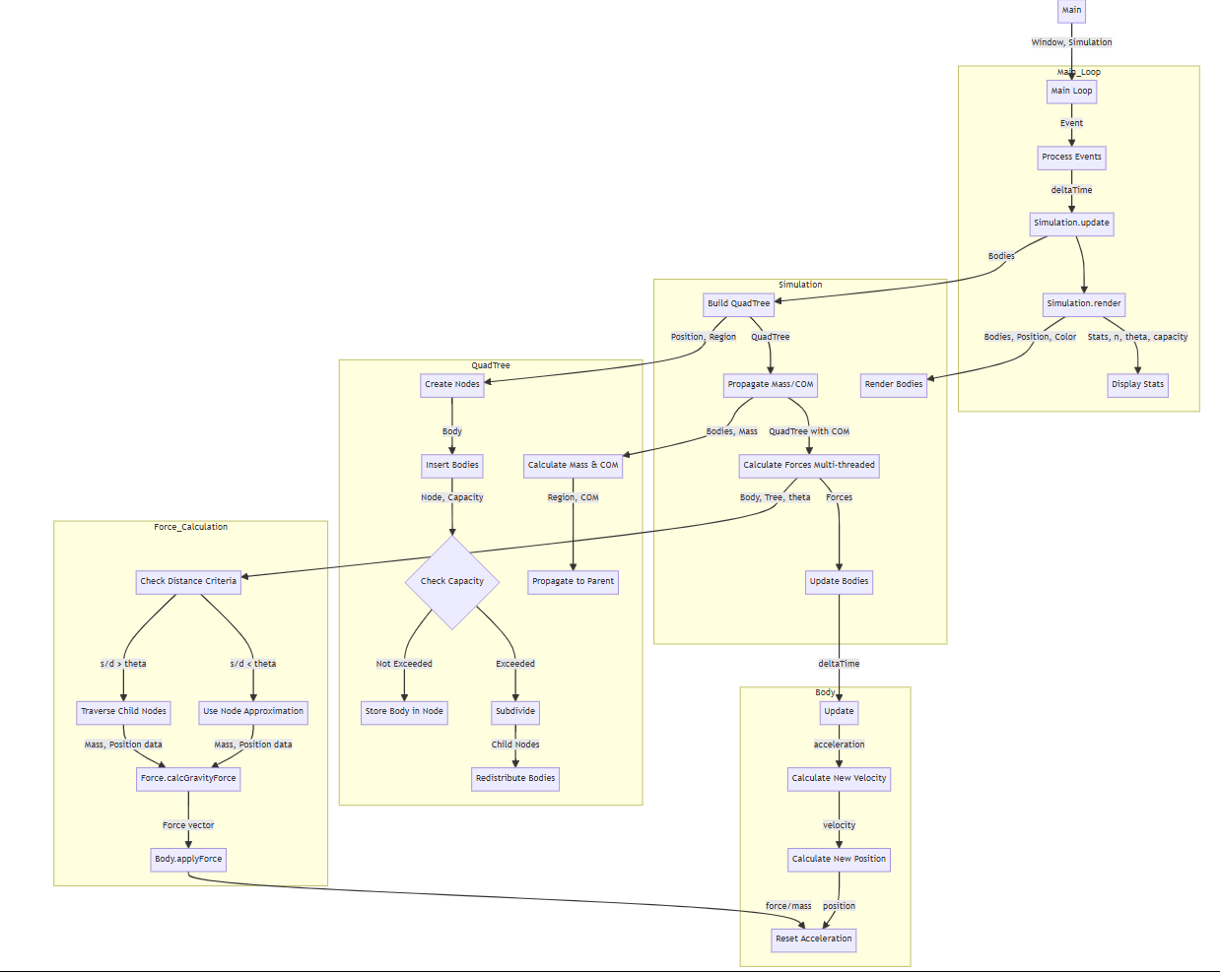
data flow Diagram
Notes:
This is an overview of the data flow.
There is a lot going on here that I don’t have time to fully cover, however I would like to focus on the simulation
Here you can see the three regions that I just discussed:
Building the quadtree
Propagating masses
And calculating forces

Slide 9
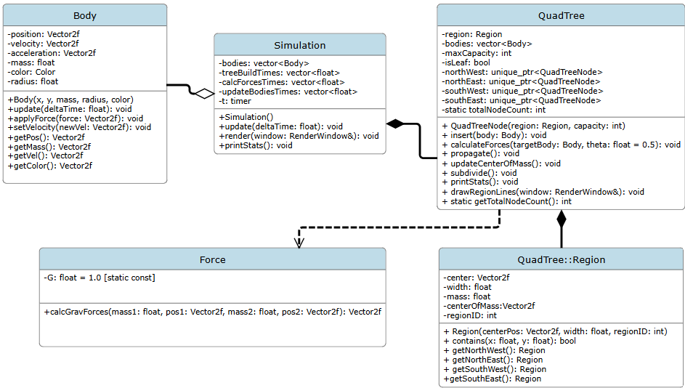
Component Diagram
Notes:
This is the component diagram for the simulator.
We have four main classes:
The body class, which defines a single body object
The simulation class, which is where we defined our initial bodies position and velocity, and where we run our main simulation loop
The Quadtree class, which defines the quadtree data structure and defines a region class
And I separated the force calculation into its own class so that in the future I may use other types of physics equations

Slide 10
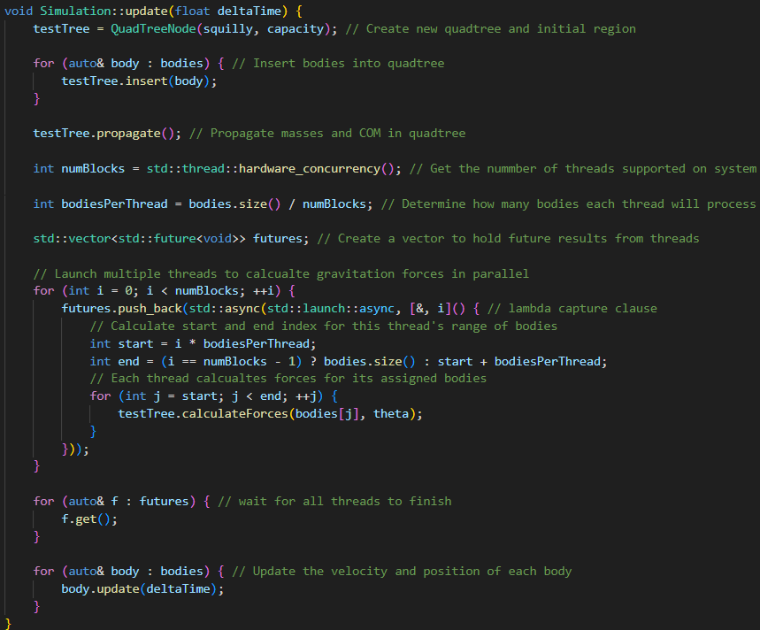
Parallelism using Futures
Parallel
Section
Notes:
We can now look at parallelizing the force computation.
This is a similar layout to what we have seen throughout the semester with futures and threads.
Divide the work evenly across the threads.
Prepare a container to hold all the running threads’ futures.
Launch one async task per thread, pushing each future into the list.
Then, inside the lambda:
Calculate the start and end index for this thread’s range of bodies.
Each thread loops over its assigned bodies, calling calculateForces() for each one
Wait for all threads to finish with futures.get()

Slide 11
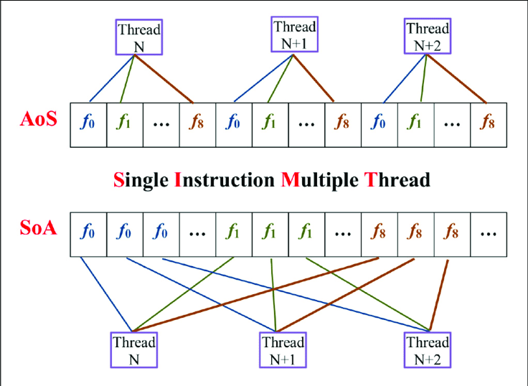
Future Improvements
Optimizing for cache and simd
Photo from Department of Electrical and Computer Engineering, North South University, Bangladesh
Example (in real time)
Example
Notes:
I do plan to continue work on this simulator because I found it interesting. My final goal is to reach one million bodies.
To do this there are some future improvements I plan to implement:
The most obvious is optimizing for cache and simd
Currently, all Body objects are stored in a single vector using an Array of Structures approach.
During simulation, forces are computed b iterating over each Body, accessing its individual properties like, position, mass, and velocity.
This is a classic example where Structure of Arrays (SoA) is a significantly better fit:
By separating characteristics into their own dedicated vectors, we improve cache locality.
This design would also be a perfect setup for using SIMD optimization.

